Slide 1
Nazi’s massacre of the Jews
Concentration on Auschwitz camp
2016312761 여혁수

Slide 2
Background of massacre
When the time is about departure of World War II, Germany was suffered by economic hardship, and Alienation in Europe.
However, at the same time, Jews occupied quite big part of Europe occupation floor with legal person, lender, banker. So the Influence of Jews in Europe economy was great.
After the outbreak of World War II, Hitler cannot but dictate the German military. So he unite German with a thought. The thought became anti-Semitism. It is enough to become because Jews are rich to live and German are poor.

Slide 3
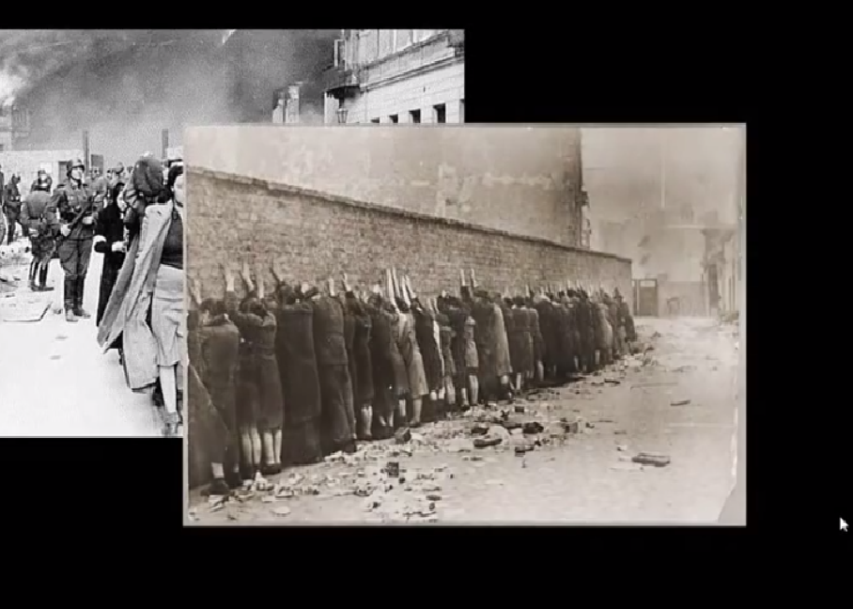
Departure of massacre
A great war reparation of World War I was charged to Germany. And Hitler started to release anger to Jews. Nazi started to build concentration camps.

Slide 4
Camp before World War II
Executions, torture and arrests of journalists and political prisoners who criticize Communist and Nazi dictatorship were carried out.
After the seizure of power, local SA commanders randomly arrested Communists and Jews.
In 1939, 6 big camps have been established.
In 1938, the SS(Schutzstaffel) began using the camps as a source of forced labor to create economic profits. Because German was very poor to fight.

Slide 5
Departure of World War II
Since the outbreak of World War II in 1939, concentration camps have gradually become places for murdering, slavery, torture and starving of conscientious objectors to the Nazi. The camps spread throughout Europe which is occupied by Nazi Germany.
The new camp was built near the large Jewish community named Polish Intelligentia, Communists and Gypsies. Since millions of Jews were in Poland, the Nazi were able to transport Jews in Germany to outside Germany's main territory by building camps in Poland.

Slide 6
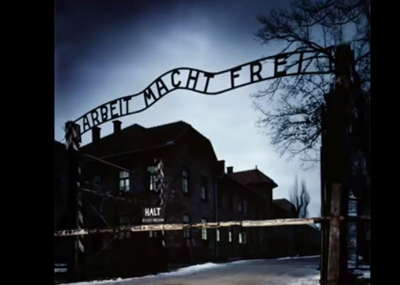
The emergence of Auschwitz
On April 27, 1940, where 1.5 million people were killed, the Auschwitz concentration camp was built in Poland.

Slide 7
Appearance of Auschwitz concentration camp
The location is about 300 km from Warsaw, Poland. It had a biggest scale ever the Nazi built.
The camp is separated to total 28 camps. The room for prisoners were too small to stand up. Beds are so terrible that matrix is composed of hair of slaughtered people and straw.

Slide 8
Prisoners in Auschwitz
The time that first prisoners came to Auschwitz is June, 1940. And they are Polish prisoner, total 728.
Prisoners came to Auschwitz by train. Train doesn’t have any cold or heat conditioner, and something to eat is not provided to prisoners, so almost of prisoners in train died by the way to Auschwitz.
Polish are imprisoned first by German military. Later, Soviet prisoners of war are accommodated, but soon became a prison for all the other peoples.(Jews, young, old…)

Slide 9
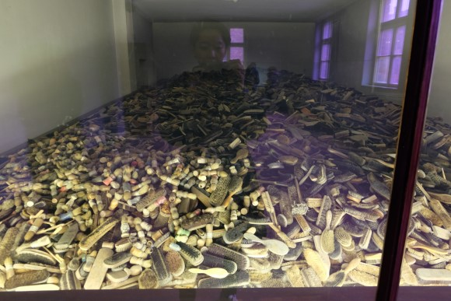
Life of prisoners in Auschwitz
On the first day, prisoners from all over Europe are taking away all their belongings. At the end of World War II, Nazi, who needed a labor force, took off their clothes on the first day of the arrival of prisoners and scanned them whether they are labor force or not in their physical condition.
The picture seem to be combs, glasses, and spoons confiscated from the prisoners.

Slide 10
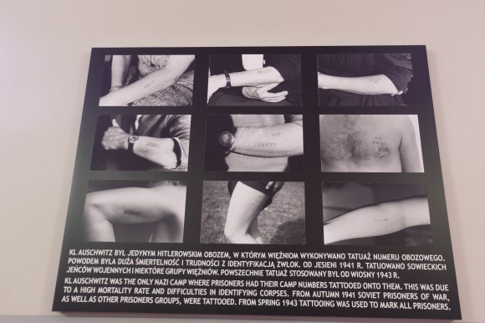
Life of prisoners in Auschwitz
As soon as prisoners arrive at the camp, they also lose their names. They no longer have names. Their new name is the prison number on their arms.

Slide 11
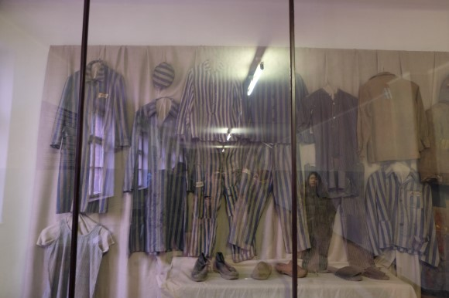
Life of prisoners in Auschwitz
In the winter, the prisoners wear winter clothes in a single layer. There were some classes within the camps. German political prisoners, criminals, Polish people wearing thick winter clothes, British men with leather jackets, but general prisoners with just single layer. It is contrary to the camp rules, but it is said that prisoners has endured the cold by putting paper.

Slide 12
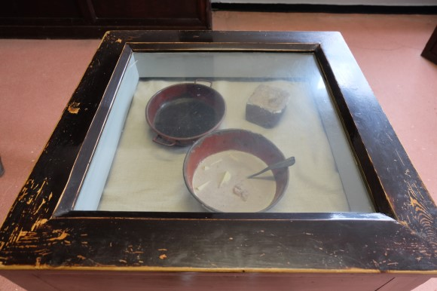
Life of prisoners in Auschwitz
There is some porridge with no toast(geondeogi).
Prisoners who consume only some water with hunger will wake up several times in the evening, and their faces are swollen and turned into terrible prisoners faces.

Slide 13
Life of prisoners in Auschwitz
Those who were classified as capable of work were subjected to constant forced labor. For example, 'Auschwitz 3' (Monovitz) was a special labor camp, which is provided many forced labor and put to I. G. Parben Synthetic Rubber Plant and Petroleum Extraction Plant.
Also, they had to do all the painful treatment that clean up the bodies of the Jews who were slaughtered.
They also had to respond to extreme human experiments. The experiments with Dr. Joseph Mengele, nicknamed "The Angel of Death," were especially horrible.

Slide 14
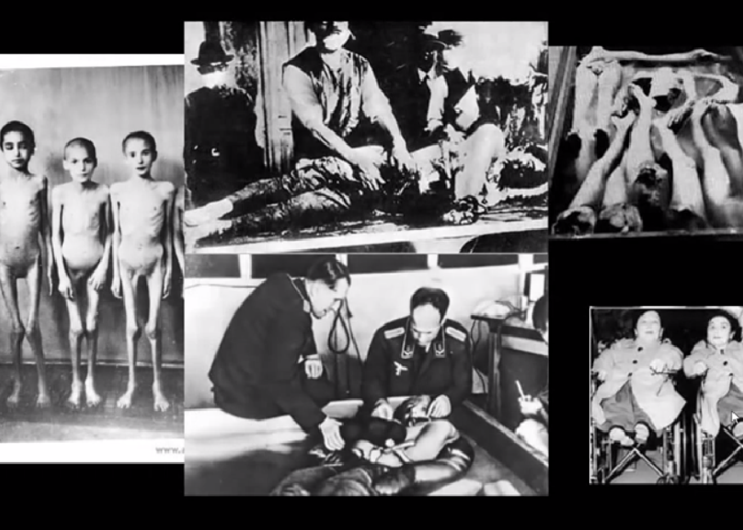
Human experiments in Auschwitz
They carried out anti-ethical bio-experiments such as cutting arms and legs, changing each other's blood, and making artificial deformed babies.

Slide 15
Massacres in camp Auschwitz
In 1941, at Hitler's command, camp was expanded to mass murder facilities and began massacres in 1942.
Among the people who were carried on the train, the weak, the elderly, and the children were immediately sent to the gas chambers disguised as common showers and killed.
The remains of the victims were used as recyclables, and jewelry and gold teeth were made to bullion. Also they collected the victims' hair and made woven carpets, grinding bones and using them as bone meal fertilizer.

Slide 16
Massacres in camp Auschwitz – poison gas room
It was the first massacre in Auschwitz in September 1941 that Soviet and Jewish prisoners were slaughtered in the poison gas room for the first time.
About 2,000 prisoners were slaughtered in the Poison Room at one time. The poison gas room was usually in the shape of a shower, and Nazi asked the victims to take a shower, took off their clothes, and sent them to the gas chambers to kill them.
The poison gas used was chiclone B, which showed fast effect.

Slide 17
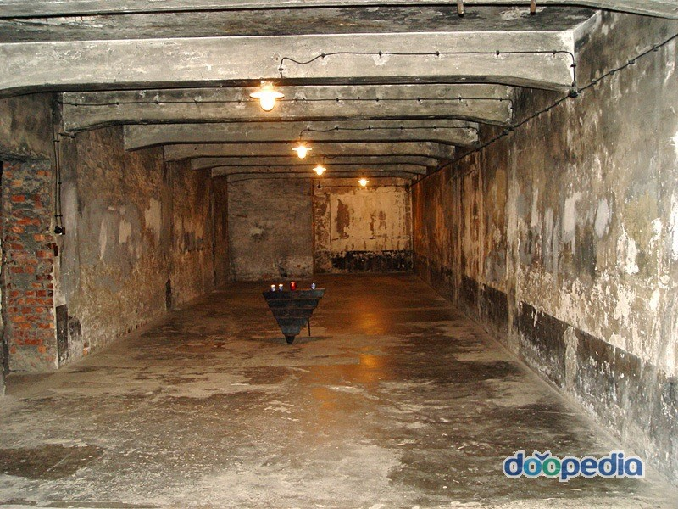
Poison Gas Room
Gas chamber outside the barbed wire. People were trapped here and injected gas called Cyclon B.

Slide 18
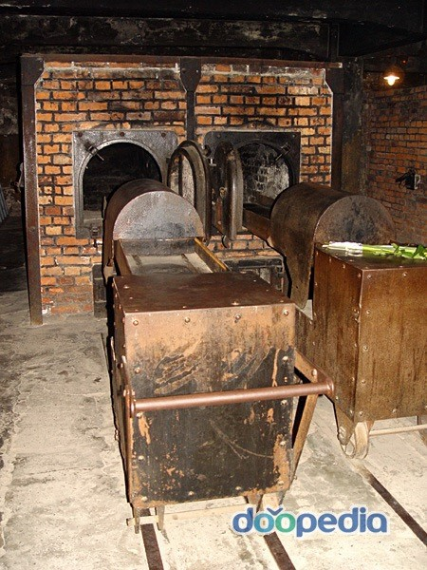
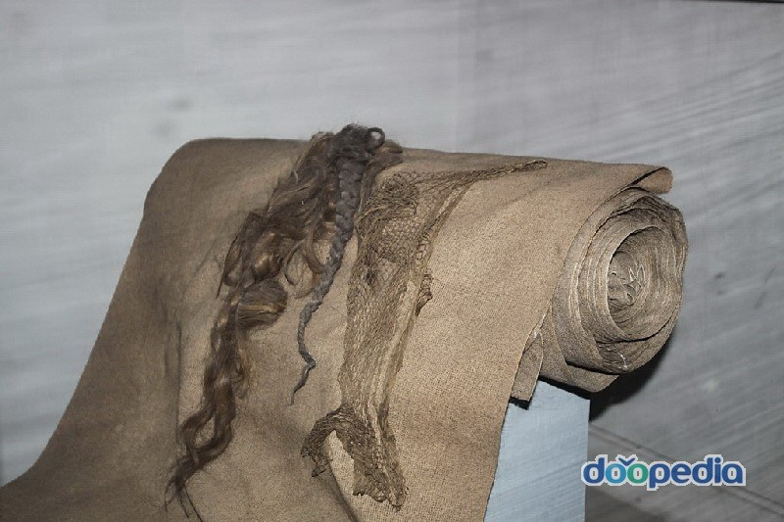
Handling of corpses
The body of the massacre was burned in large quantities in a body incinerator, with bodies of about 1,500 to 2,000 bodies per day being incinerated.

Slide 19
Various data about the number of victims
According to the announcement of the former Soviet army that liberated the camps at first, about 4 million people were killed in Auschwitz, which of 2.5 million are Jews.
Later, according to News Story on January 18, 1995, the number of people who died in Auschwitz was estimated at 1.1 million to 1.5 million, including Jews.
In 2005, a report on the 60th anniversary of the release from Auschwitz, the number of Jewish victims is written to 1 million. Besides the Jews, more victims are Polish prisoners, former Soviet prisoners, and Gypsy peoples. All do not know exactly how many people died, but it is clear that the most victims are Jews.
In August 1944 at the Auschwitz concentration camp, 24,000 people were killed in a single day.

Slide 20
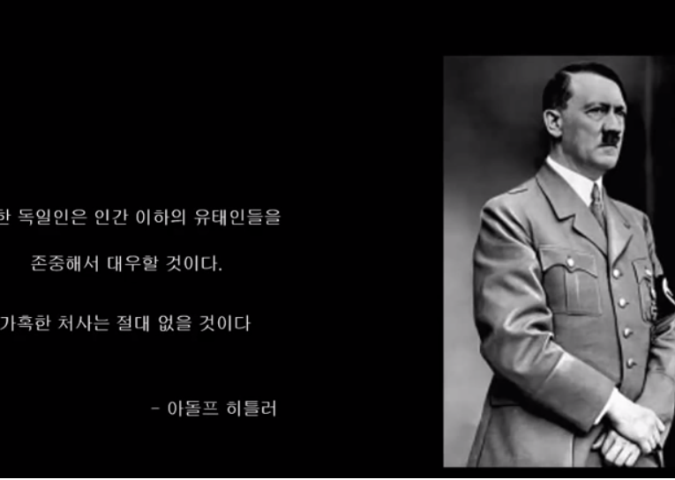
After the World War II…
In January 1945, at the end of the war, the Nazi burned down the barracks and destroyed the buildings to wipe out the evidence of genocide. However, the Soviets arrived sooner than expected, leaving some of the camp buildings and barracks without being destroyed.
In order to not forget the victims of the atrocities of the Nazi, UNESCO designated Auschwitz as a world heritage site in 1979.

